Slide 1
Treasure Land Game
Presentation By: Ria Sangwan

Slide 2
Project Overview
Treasure Land Game is a text-based adventure game developed using Python.
The player progresses by making choices at different stages.
Each decision affects the game outcome.
Wrong choices lead to game over, correct ones move the player forward

Slide 3
Problem Statement
There is struggle to understand conditional logic in Python in beginning.
Need for a simple project to practice:
If-else, User input handling, Logical decision-making
Solution: Create an interactive game using Python conditions and user inputs.

Slide 4
Objectives
Technologies Used
Build a beginner-friendly Python game.
Implement decision-based game flow.
Improve logical thinking using conditionals statements.
Learn how user input controls program execution
Programming Language: Python
Concepts Used:
Conditional statements(if, elif, else)
User input(input())
String handling
Basic program flow control

Slide 5
Game Flow
Game starts with a welcome message.
Player chooses a direction(Left/Right).
Next choice depends on previous decision.
Correct choices continue the game.
Wrong choices result in Game Over.
Final correct choice leads to Treasure Found.
Sample Game Choices
Choose a direction: Left or Right
Choose an Action: Swim or Wait
Choose a door: Red, Blue or Yellow
Each choice changes the game outcome

Slide 6
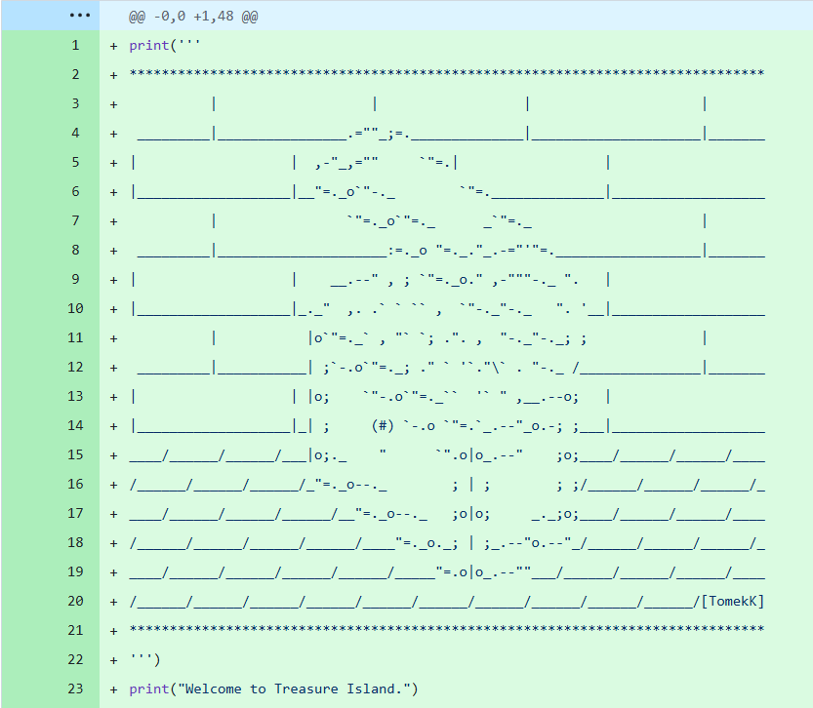
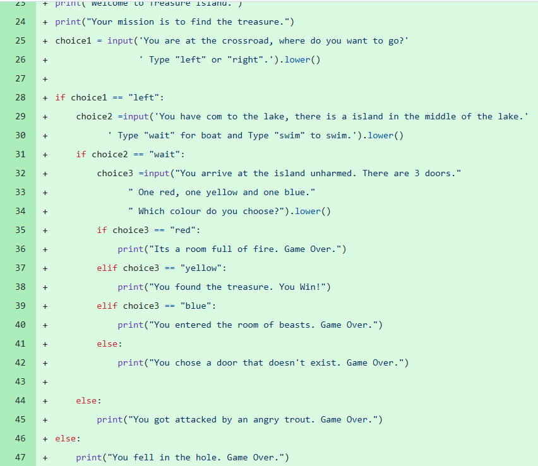
Code Snippet

Slide 7
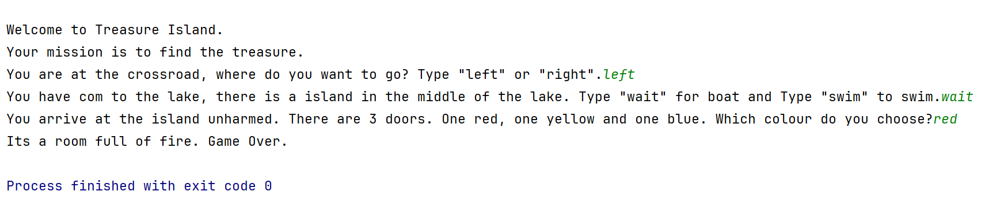
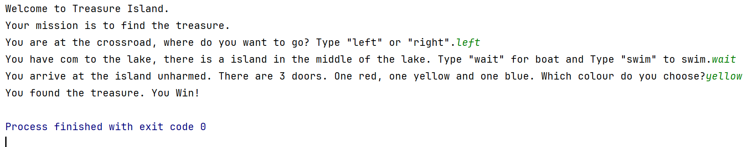
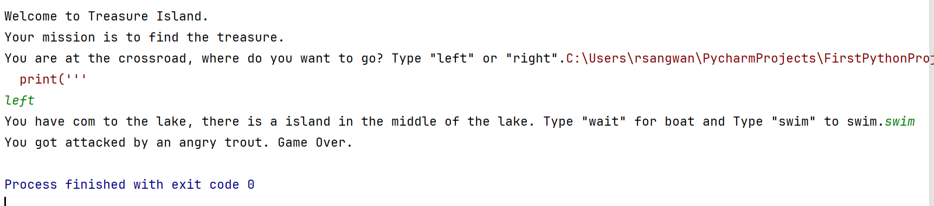
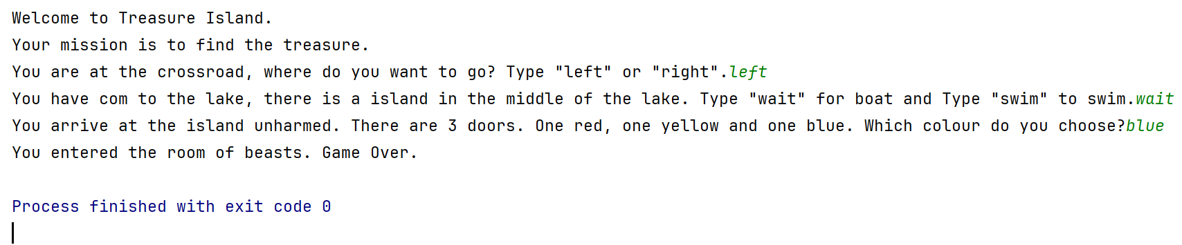
Output Screens
Displays text prompts for user choice.
Shows Game Over when wrong choice is made.
Displays You Win! When treasure is found

Slide 8
Key Learnings
Challenges Faced
Improved understanding of:
Conditional Logic
Nested if-else
User interaction in Python
Learned how small decisions affect program flow
Gained confidence in writing Python Programs
Handling multiple conditions correctly.
Avoiding logical errors in nested if-else.
Ensuring smooth game flow

Slide 9
GitHub Repository
Source Code available on GitHub Github Repo
Clean and beginner-friendly code
Easy to understand and modify

Slide 10
Conclusion
Treasure Land Game is a simple yet effective Python project
Ideal to understand decision-based logic
Good to strengthen Python fundamentals through hands-on learning

